Slide 1


Session #4:
Arithmetic Operators.
How to ask users to input data?
Converting data types.
Solving computer problems.
Decision making.

Slide 2
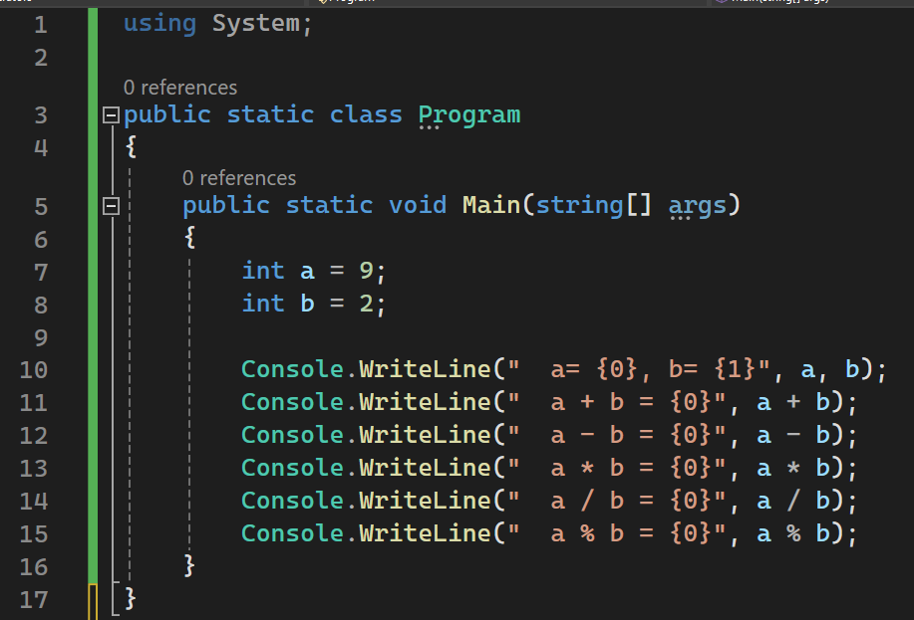
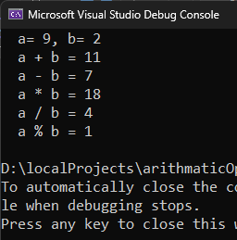
C# Arithmetic operators part 1.
+ , - , / , * , %.

Slide 3
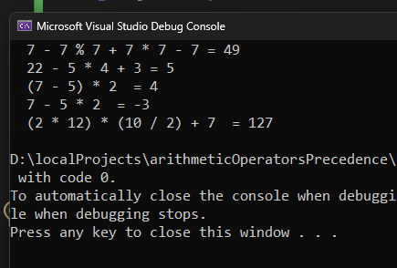
C# Arithmetic operators precedence.
() > / > * > % > + > -
Examples
7 – 7 % 7 + 7 * 7 – 7 = ?
22 – 5 * 4 + 3 = ?
(7 – 5) * 2 = ?
7 – 5 * 2 = ?
(2 * 12) * (10 / 2) + 7 =?

Slide 4
How to ask users to input data?
Console.ReadLine()
How to convert different data types?
Convert.ToInt32
ToString()
Practice:
Write a c# console program that asks for two numbers and display sum of them.

Slide 5
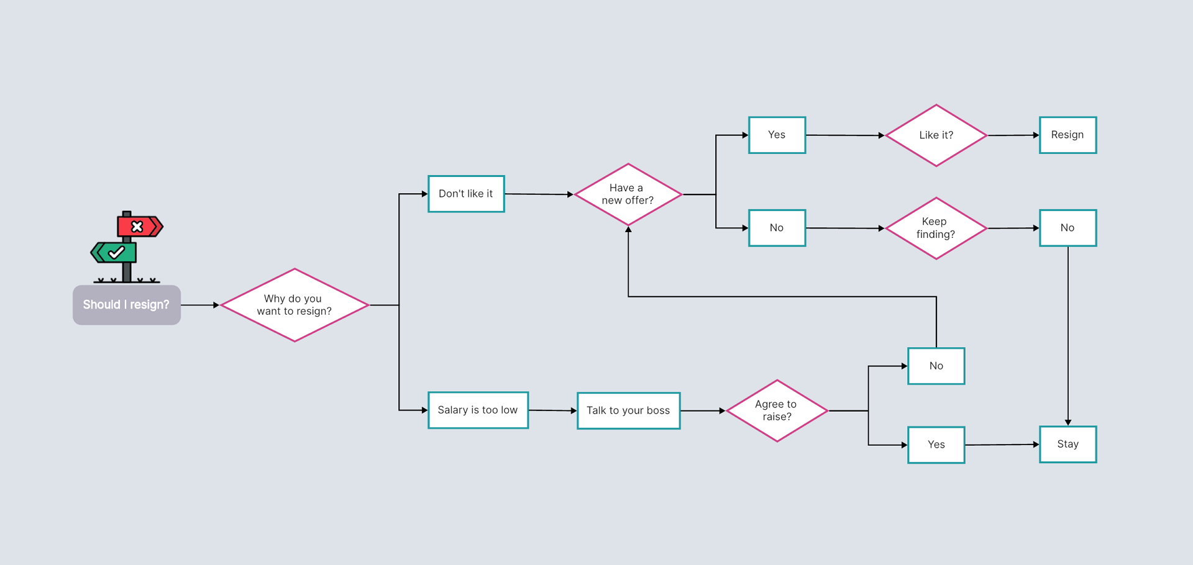
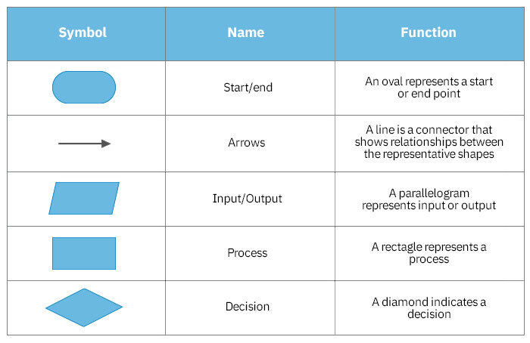
How to solve computer problems?
We start with structural practice then move to object oriented.
Subdivisional problem solving.
Steps required to solve a problem:
Understand the problem.
What information we have?
What information we must reach?
How we could reach from input information to the results?
Write down the algorithm.
Test it on the paper.
Code the algorithm into the program.
Flowcharts.

Slide 6
How to solve computer problems?
Make a computer program that calculates the area and perimeter of a rectangle given its sides.
What information we have?
Height | User input
Width | User input
What information we must provide (output)?
Area | (Height * Width) * 2
Perimeter | Height * Width

